Slide 1
Atlas Itinerary
By Gabriel Taylor, Dustin Zook, Sorelle Djuissi, Gabriyel Sorensen

Slide 2
Introduction & Purpose
Atlas Itinerary is a personal travel itinerary planner.
After creating an account, users can build trips for specific destinations.
The primary purpose of Atlas Itinerary is to provide a single web application where users can search for places, select the ones they care about, and plug them into a calendar-like structure for their trip.

Slide 3




Technology
React and Next.js
  Used to build the front-end of the application and deal with routing between the pages.
Supabase
  Provides a relational database that integrates smoothly with React and Next.js.
  Also provides Authentication through providers like Google.
Google Places API
  Primary provider of locations and location information.
Vercel
  Hosts the server.
  Integrates directly with GitHub and Next.js, handling deployment.
Notes:
Talk about each Technology & why they were used. Describe how easy/difficult it was to come up to speed for each. Explain how they made development easier. Talk a bit about the change from Firebase to Supabase and TripAdvisor to Google Places.

Slide 4
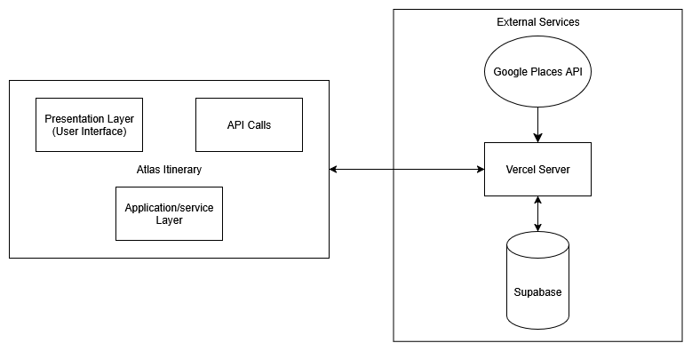
Design description: Overall Architecture
Presentation Layer
  React components and pages
Application/Service Layer
  Typescript helper modules containing business logic and data access functions
External Services
  Google Places API - searching for locations and retrieving place details
  Supabase - Database and Auth
  Vercel - Server for hosting

Slide 5
Design description: Major Pages & Components
Home / Instructions Page
  Provides an overview of the application and instruction on how to create and manage itineraries.
Itinerary Details Page
  The core of the application, being where users can create itineraries and build them by adding locations.
  Allows users to search for nearby locations, retrieved from Google Places, for their travel destination
Itinerary List Page
  Where user can see a list of all their created itineraries and manage them.
  Can inspect each itinerary and view all of the added locations in a calendar view.

Slide 6
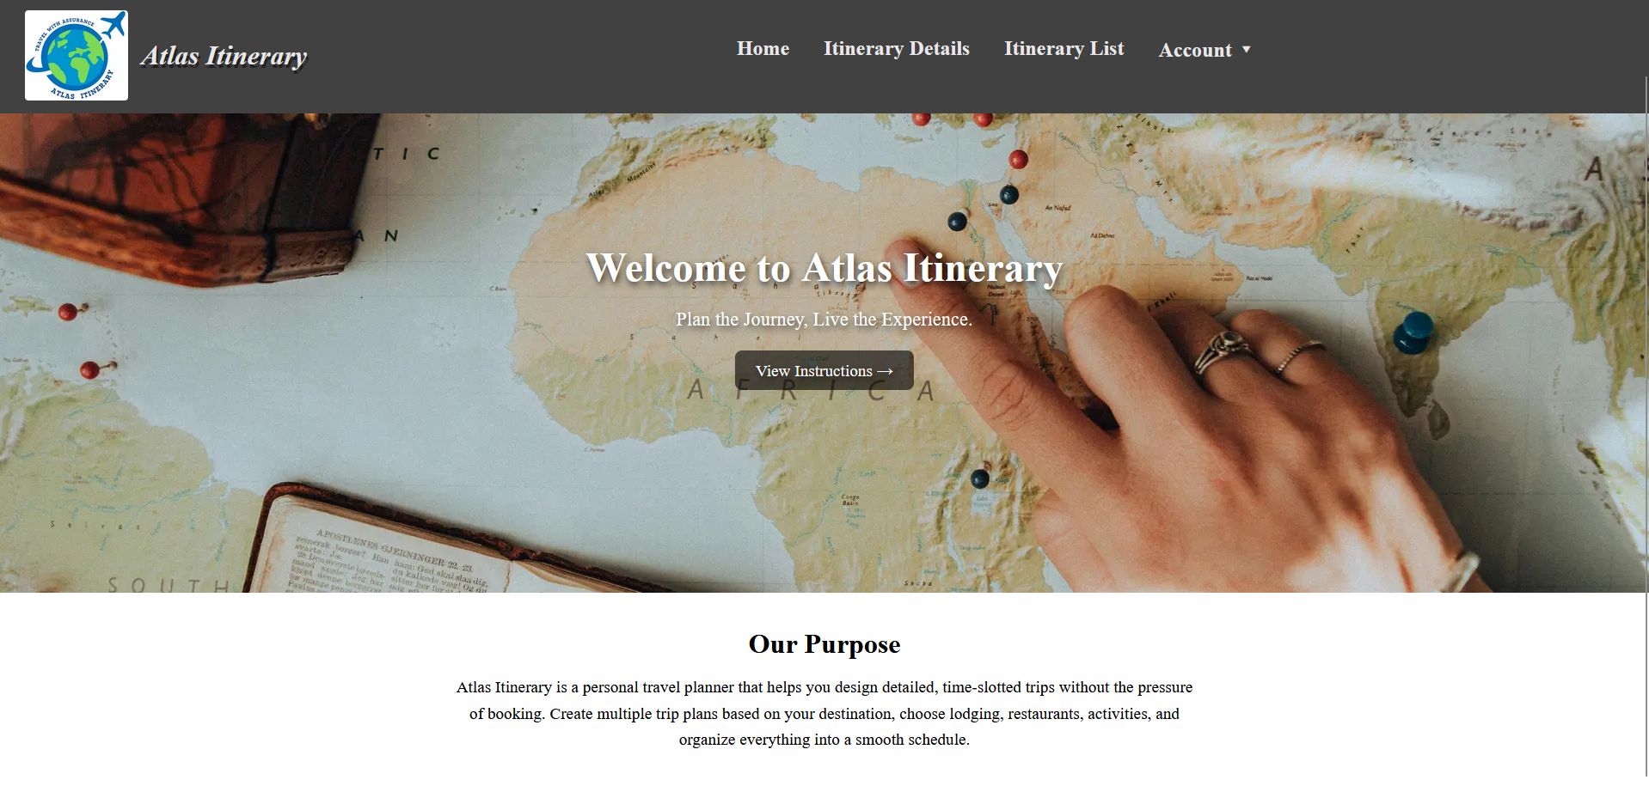
Design description: Home

Slide 7
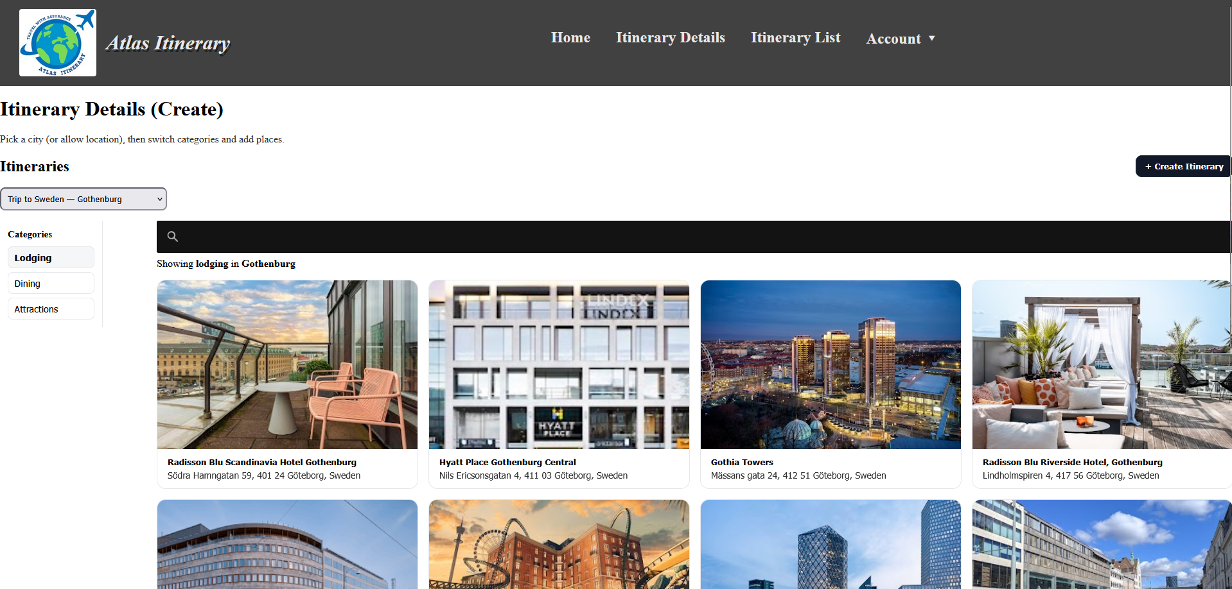
Design description: Itinerary Details

Slide 8
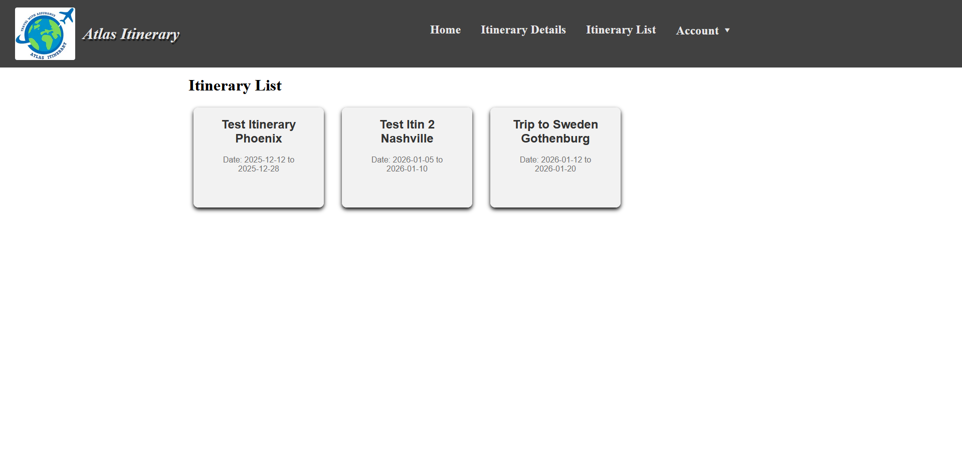
Design description: Itinerary List

Slide 9
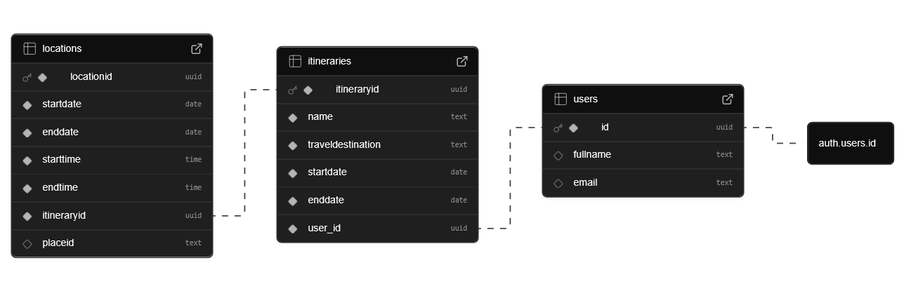
Design description: Database
Supabase’s Schema Visualizer of our project’s public schema

Slide 10
Design description: Server-Side scripts
API routes
  Next.js route handlers that perform server-side calls to the Google Places API.
Middleware (middleware.ts)
  Runs before certain routes and checks the Supabase session.
  Provides page protection for Home, Itinerary Details, and Itinerary List.
Auth callback
  API route that handles the OAuth callback from Google.

Slide 11
How to deploy
Start by downloading the code from GitHub.
Ensure Node.js is installed and running.
Ensure all the environment variables are set up.
  This will require setting up a Google Cloud project and Supabase project.
Create the Itineraries and locations table in Supabase.
The code can be run locally either in development mode or compiled to run in production mode.
To deploy on Vercel, either:
  use Vercel CLI to deploy it from the command line
  Create a git repository and link it to Vercel

Slide 12
Known issues
The Create Itinerary search bar can disappear after navigation
  The search bar will appear when the first go to the Create Itineraries page.
  But, if the user goes to another page and navigates back, the search bar will no longer be there

Slide 13
Questions before the demonstration

